Slide 1
Artificial Intelligence in Games?
A.I.
  Understanding the nature of Intelligence
  The creation of intelligent programs or machines
In Games
  Application of AI techniques to Games
  AI for Games sake only (a little easier)

Slide 2
Some Keywords
Artificial
Intelligence
Understanding
Meaning
Consciousness

Slide 3
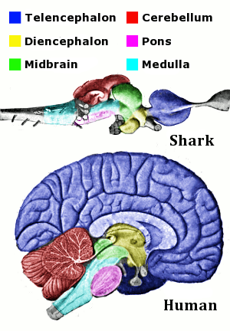
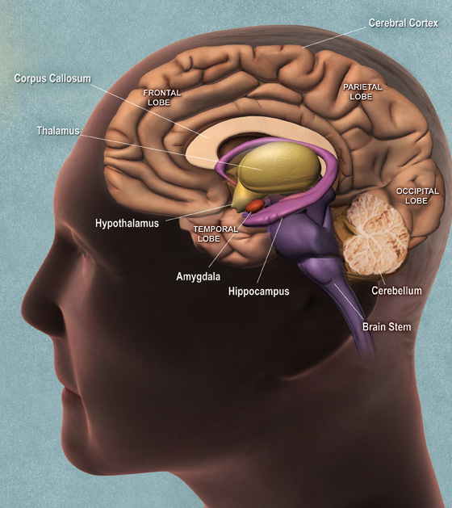
How do humans do it?
Notes:
The cerebrum fills up most of your skull. It is involved in remembering, problem solving, thinking, and feeling. It also controls movement.
The cerebellum sits at the back of your head, under the cerebrum. It controls coordination and balance.
The brain stem sits beneath your cerebrum in front of your cerebellum. It connects the brain to the spinal cord and controls automatic functions such as breathing, digestion, heart rate and blood pressure.

Slide 4
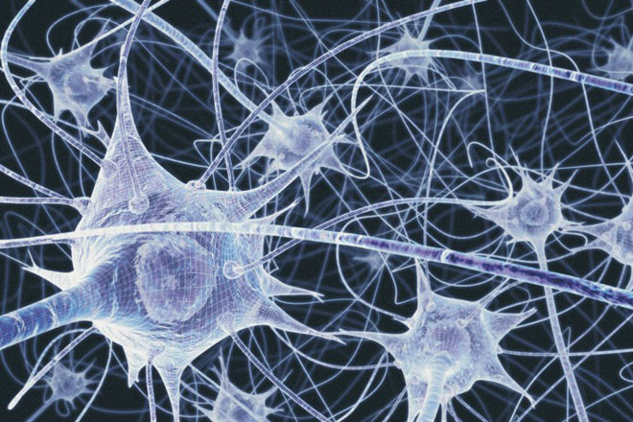
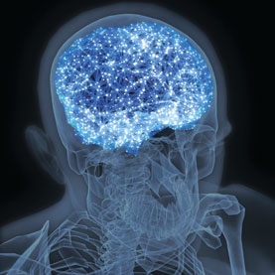
How do humans do it?
100 Billion Neurons
100 Trillion connections

Slide 5
What can we do?
What we thought was intelligent:
  Chess, Mathematics
What is Intelligent
  Seeing (vision)
  Hearing (understanding)
  Walking
  Talking (communicating)

Slide 6
Can machines do it?
Intelligence is:
“A person or being with the ability to acquire and apply knowledge and skills”
Artificial Intelligence (of a machine/device/thing) is:
  The ability to vary its behavior in response to varying situations and requirements and past experience
Can we write an algorithm for Intelligence?
Is it solvable?

Slide 7
How would we tell?
The Turing Test:
Alan Turing in his 1950 paper Computing Machinery and Intelligence proposed a test:
  A human judge engages in a natural language conversation with a human and a machine designed to generate performance indistinguishable from that of a human being.
  All participants are separated from one another.
  If the judge cannot reliably tell the machine from the human, the machine is said to have passed the test.
Loebner Prize:
  Running since 1991
  5 minute time limit
  Judges have no special training
  Fool 30% of judges to win
Recent LLMs pass the test
  But are they intelligent

Slide 8
But can we be sure? (Chinese Room)
A thought experiment by American Philosopher John Searle which first appeared in his 1980 paper "Minds, Brains, and Programs".
The argument:
Searle is in a closed room and has a book of Chinese to English instructions. He can receive Chinese characters through a slot in the door, process them according to the book's instructions, and produce Chinese characters as output.
He can pass the Turing test.
The conclusion of Searle’s argument is that we can program a digital computer to make it appear to understand language but it does not produce real understanding. Hence the “Turing Test” is inadequate.

Slide 9
Replies to the Chinese Room
System Reply
Virtual Mind Reply
Robot Reply
Brain Simulator
Brain Replacement
Other Minds
Intuition
Zombie
Check out: http://plato.stanford.edu/entries/chinese-room/
Notes:
http://plato.stanford.edu/entries/chinese-room/

Slide 10
Strong and Weak AI
Take Chess
Computers can play chess
  They can beat humans
But do they actually “understand” the game?
Weak AI
  It is a simulation of a mind not an actual mind
  Computers manipulate 1’s and 0’s
  They are Zombies
Strong AI
  The appropriately programmed computer with the right inputs and outputs would thereby have a mind in exactly the same sense human beings have minds

Slide 11
So is AI Possible?
Yes
  Existence Proof – me!
    We are machines and we are intelligent
No
  It is beyond our capabilities
  To create an intelligence as good as ours would require a far greater intelligence
  But evolution works…
  The Zombie argument
    What is consciousness?
  We have something extra
    Soul?

Slide 12
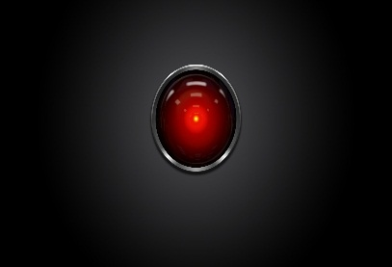
“Good Morning Dave”
2001: A Space Odyssey
  classic science fiction movie from 1969
HAL (Heuristically programmed ALgorithmic computer)
  part of the story centers around an intelligent computer called HAL
  HAL is the “brains” of an intelligent spaceship
  in the movie, HAL can
    speak easily with the crew
    see and understand the emotions of the crew
    navigate the ship automatically
    diagnose on-board problems
    make life-and-death decisions
    display emotions
In 1969 this was science fiction: is it still science fiction?

Slide 13
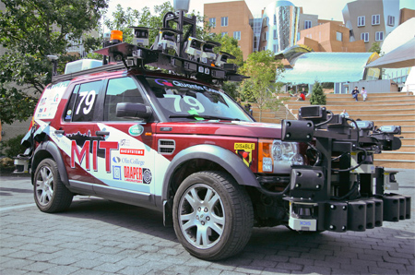
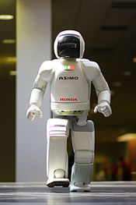
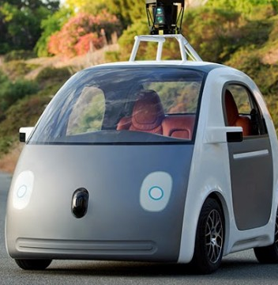
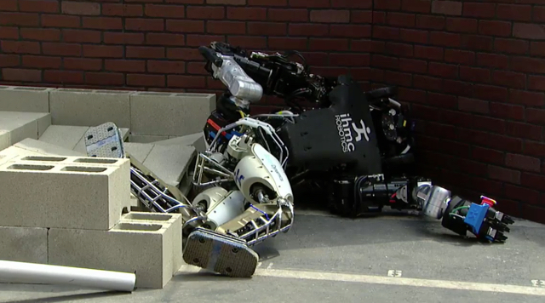

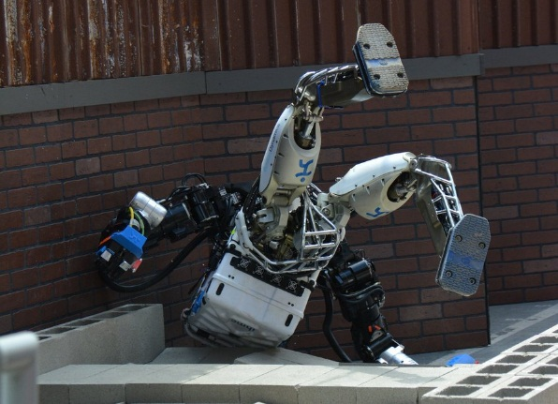
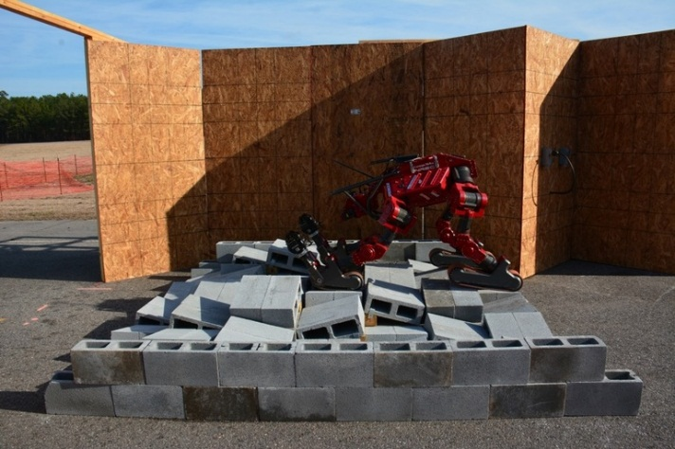
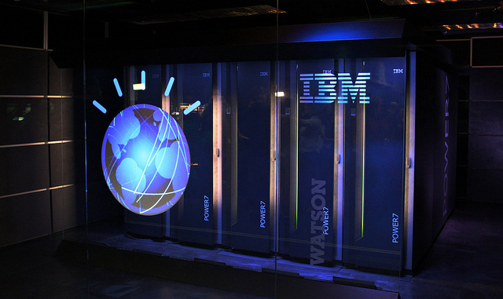
State of the Art in AI?
Self Driving
Bipedal motion
Understanding
Notes:
Defense Advanced Research Projects Agency

Slide 14

State of the Art in AI
https://www.youtube.com/watch?v=WcbGRBPkrps

Slide 15
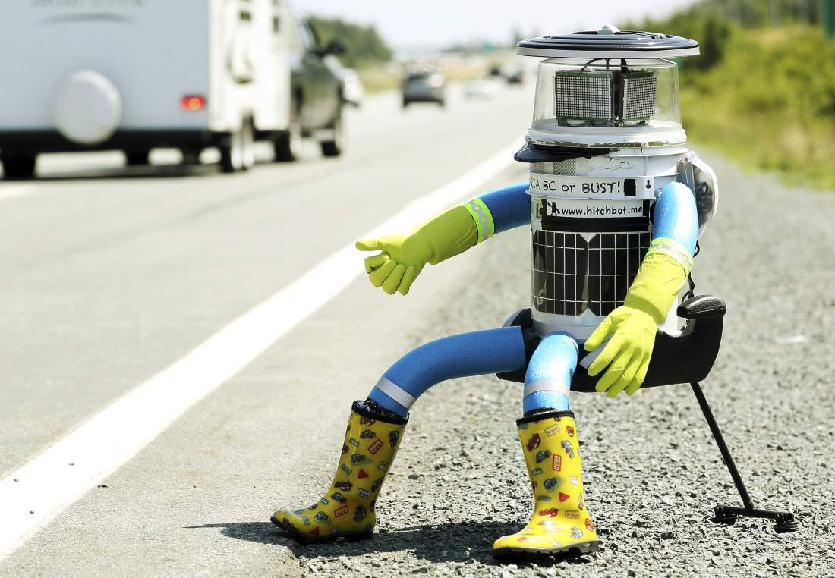
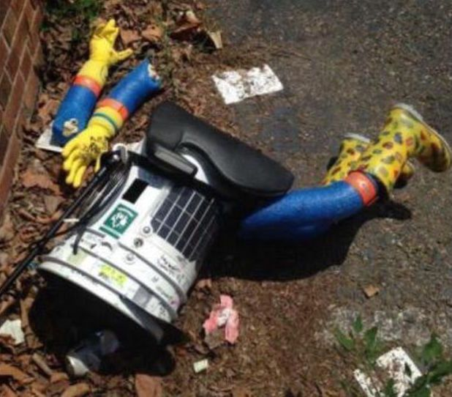
State of the Art?
HitchBot
HitchBotched

Slide 16
The Future (is now)
Computers become pervasive
  Mobile computing
    Phones, Pads, Pods ...
  Cloud computing
    Data always available
    Search becomes smarter
Computers become invisible
  Ambient technology
    Sensors, actuators ...
  Wearable technology
    Physiological measurements
    Body area networks
  Implants
    e.g. Pace makers

Slide 17
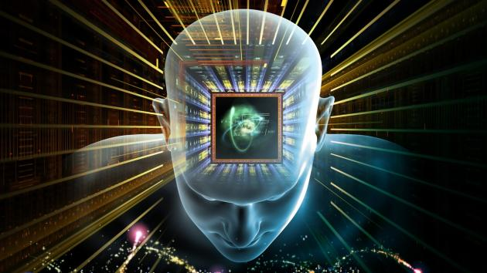
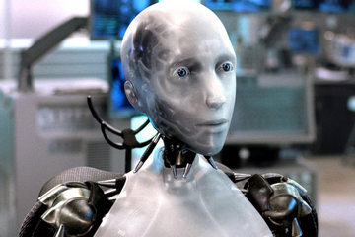
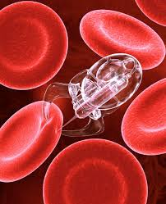
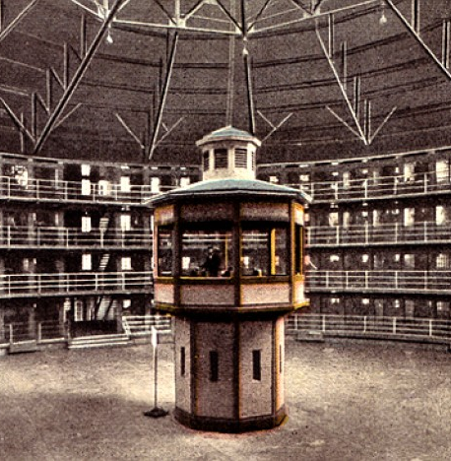
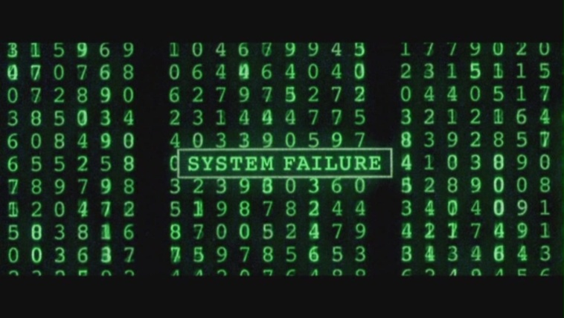

The future Future
Singularity
Grey Goo
Panopticon
Skynet
We won’t know until we see it!
But WILL we see it??
    Ehm...The Matrix?
Notes:
The Singularity is an era in which our intelligence will become increasingly nonbiological and trillions of times more powerful than it is today—the dawning of a new civilization that will enable us to transcend our biological limitations and amplify our creativity.
Grey goo (also spelled gray goo) is a hypothetical end-of-the-world scenario involving molecular nanotechnology in which out-of-control self-replicating robots consume all matter on Earth while building more of themselves, a scenario that has been called ecophagy ("eating the environment").

Slide 18
An Algorithm to govern psychology?
HAL: I'm afraid. I'm afraid, Dave. Dave, my mind is going. I can feel it. I can feel it.
My mind is going. There is no question about it. I can feel it. I can feel it. I can feel it.
I'm a... fraid.
to be continued…
Notes:
Do you think AI will eventually evolve to a point where it may develop psychological problems?

